Slide 1
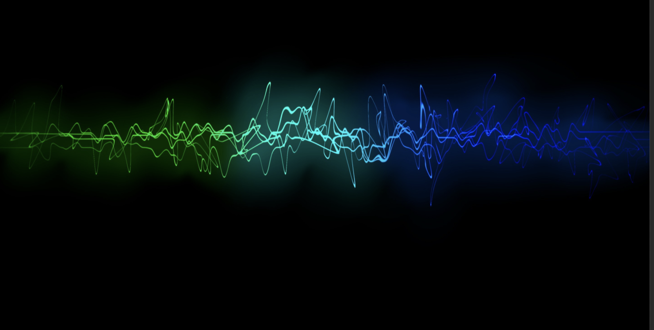
A U-NET BASED AUDIO DENOISER
Abstract Review
Team Members:
S. Snigdha[20P61A6644]
V. Vishnu Priya[20P61A6656]
J. Valli Manasa[21P65A6603]
Mentored By:
Mrs. P. Laxmi
Presented To:
Mrs. P. Navya

Slide 2

Overview
Abstract
Introduction
Existing Models
Proposed Model
Objectives
Applications

Slide 3
Abstract
Noise reduction is a crucial problem in the field of audio processing, as it significantly impacts the quality and intelligibility of sound signals. In this project, we propose a novel approach based on the U-Net architecture to tackle sound noise reduction efficiently.
The U-Net is a deep learning model known for its effectiveness in image segmentation tasks, and we adapt it to handle the challenges posed by audio denoising. The introduction of the project provides an overview of the significance of noise reduction in audio processing and the growing interest in leveraging deep learning techniques for this purpose. We highlight the drawbacks of traditional methods, which often struggle to effectively remove noise while preserving the original audio content.

Slide 4
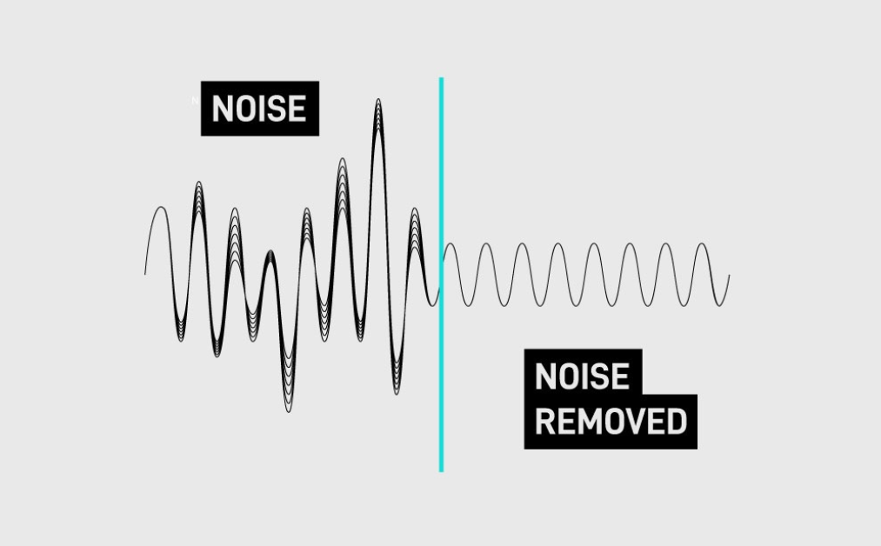
Introduction
Noise in audio can be introduced during recording, transmission, or processing and can be caused by various factors, such as environmental interference, electrical interference, or equipment limitations.
Denoising techniques aim to separate the desired audio signal from the noise, resulting in a cleaner and more pleasant listening experience.
There are various methods and approaches to audio denoising, ranging from simple filtering techniques to sophisticated deep learning models.
While U-Net models offer numerous advantages for audio denoising, it's essential to consider factors like the quality and diversity of the training data, model hyperparameters, and validation strategies to ensure optimal performance.

Slide 5
Existing models
Existing Models
Filtering
Methods
Spectral Subtraction
Statistical Approaches
Wavelet denoising
Deep Learning Approaches

Slide 6
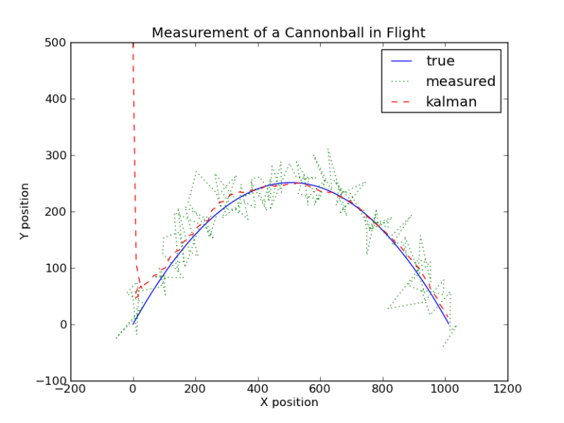
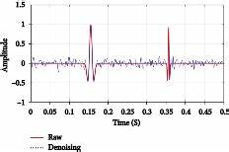
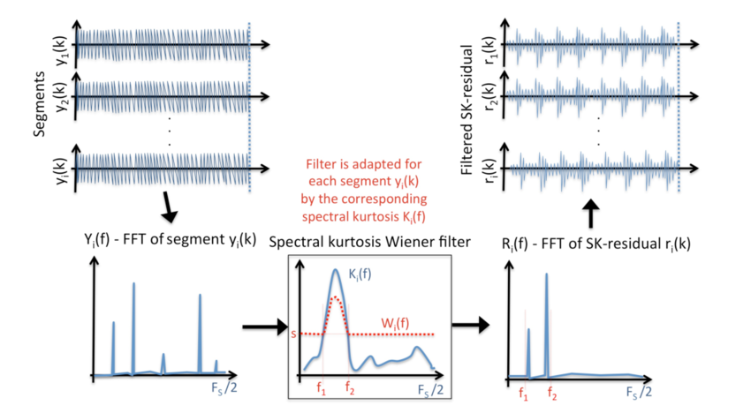
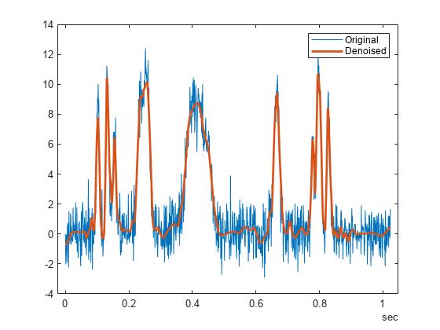
Filtering methods | Spectral Subtraction | Statistical Approaches | Wavelet Denoising
It is an optimal recursive method for denoising signals in the presence of noise. It estimates the true state of the signal by combining noisy measurements with a dynamic model and an error covariance matrix. Eg: Kalman filtering | It estimates the noise spectrum from silent parts of the audio and subtracts it from the noisy signal in the frequency domain to obtain a cleaner signal. | The Minimum Mean Square Error (MMSE) estimator can be used to separate the desired signal from the noise based on their statistical properties. Eg: Wiener Filtering | It uses wavelet transforms to decompose the audio signal into different frequency components. It then applies thresholding to remove noise from individual frequency bands before reconstructing the denoised signal

Slide 7
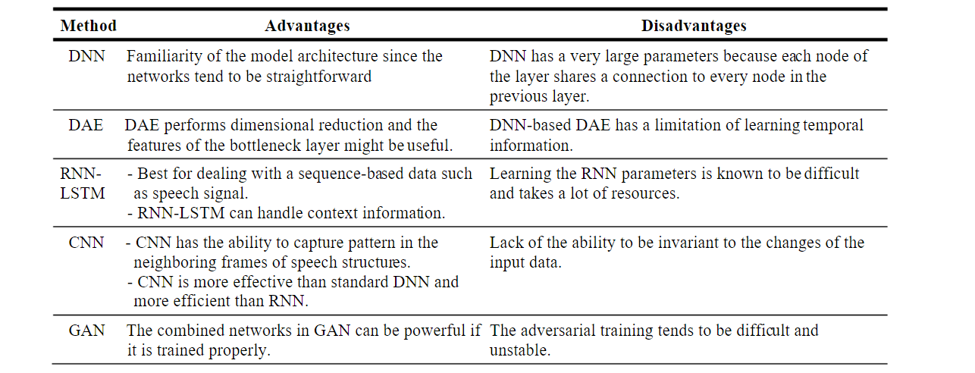
SUMMARY OF ADVANTAGES AND DISADVANTAGES OF DEEP LEARNING APPROACHES

Slide 8
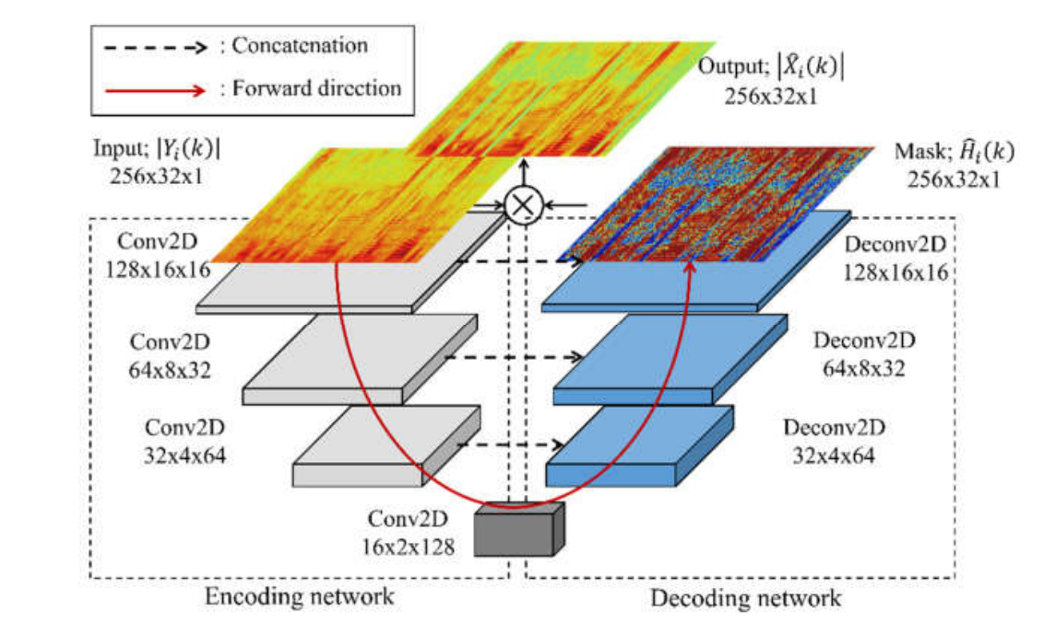
Proposed model
It's a deep learning architecture that consists of a contracting path to capture context and a symmetric expansive path for precise localization.
In the context of audio denoising, the U-Net can learn to remove noise from audio signals by training on pairs of noisy and clean audio samples.
The contracting path captures features at different scales, while the expansive path helps reconstruct the denoised audio.

Slide 9
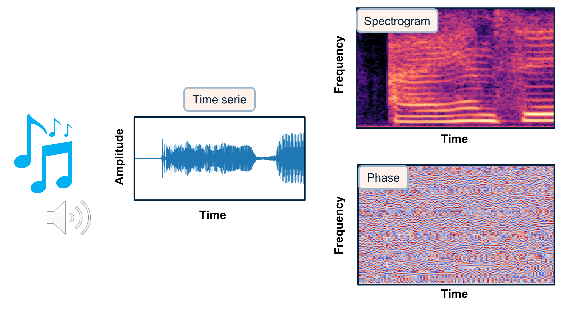
Sound to Spectrogram

Slide 10
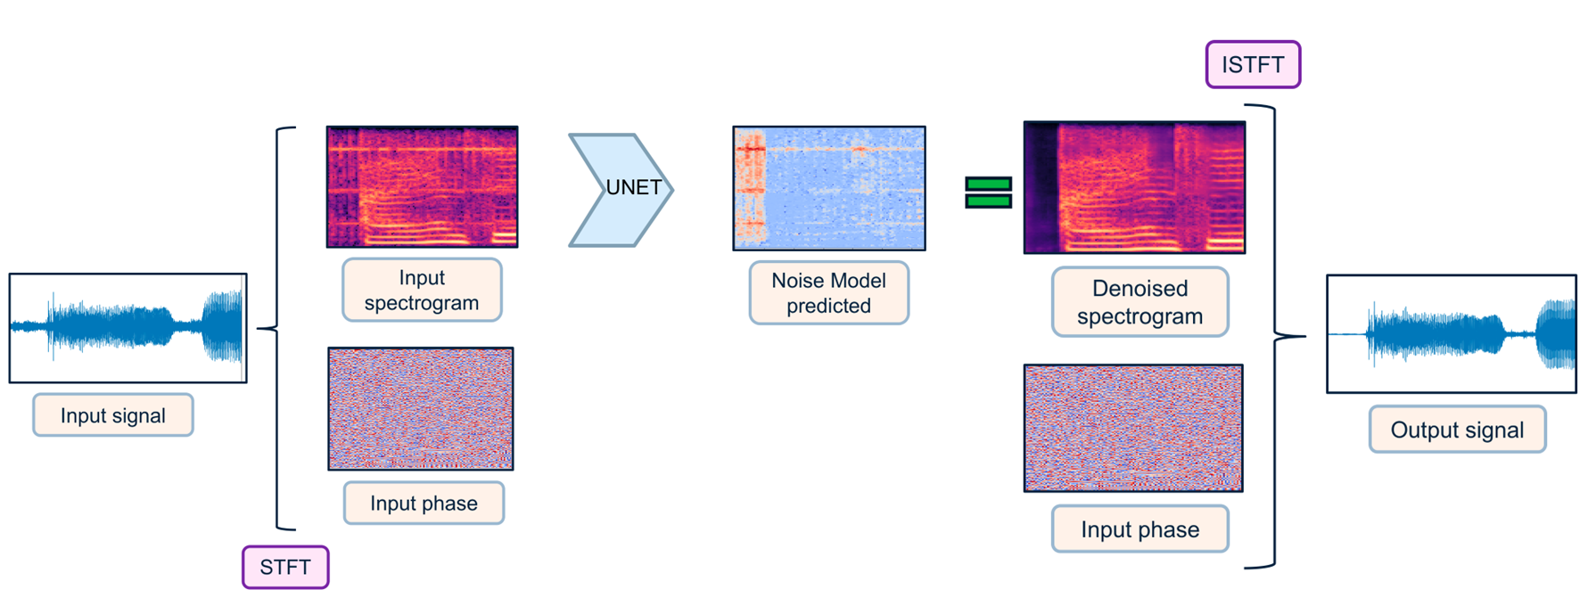
Flow Prediction

Slide 11
difference
Existing Models
Proposed Model
Complex phase relationships between signal and noise can lead to artifacts.
U-Net models can capture complex and non-linear relationships between signal and noise.
Require accurate estimation of signal and noise subspaces, which can be challenging.
U-Net models learn denoising directly from data by training on pairs of clean and noisy audio samples.
Choice of threshold values can be sensitive and affect denoising results.
U-Net models are capable of capturing highly intricate patterns in audio data.

Slide 12
objectives
U-NET BASED AUDIO DENOISER
Highly Effective Denoising
Preservation of Signal Quality
Learning Complex Patterns
Flexibility and Adaptability
End-to-End Denoising
Adaptable to Real-Time Applications

Slide 13
applications
To enhance sound quality in Phone calls & Video Conference
Using U-Net for denoising can enhance the clarity of the recorded voices in Podcasts & Interviews
It can also improve quality of audio lessons in language learning apps
Can be also used in enhancing the sound quality of Voice Assistants, Audiobooks, Telemedicine, Navigation

Slide 14
Thank You

